Slide 1
Programming fundamentals
Lecture 21: Practice of Pointers

Slide 2
Recap
Array of pointers
Multiple indirections
Initializing a pointer
The Null Pointer Convention
Dynamic Allocation Using new and delete
Pass by pointer
Using pointers in functions

Slide 3
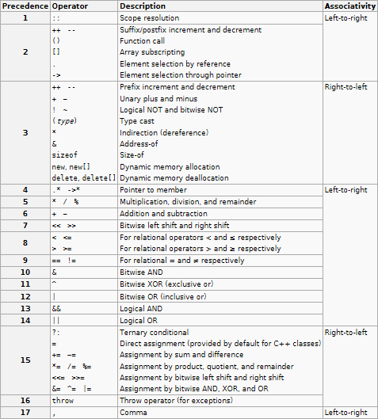

Slide 4
Agenda
Practice examples related to each core topic
Lab tasks

Slide 5
Pointers

Slide 6
#include <iostream>
using namespace std;
int main()
{
int x, y, * p,*q, ** r;
x = 10; y = 12;
p = &x;
q = &y;
r = &p;
return 0;
}
r
00FFF
00FE0
Pointer to a pointer
p
0001
00FFF
Pointer to an int
x
10
0001
Int variable

Slide 7
Contents vs addresses (way to access)
Contents
Address
Way to access content
Way to access address
Way to access int value (contents of variable) that a pointer points to
Way to access contents of location that a pointer points to
r
00FFF
00FE0
r
&r
**r
*r
Pointer to a pointer
p
0001
00FFF
Pointer to an int
p
&p
*p
-
x
10
0001
x
&x
-
-
Int variable

Slide 8
Contents
Address
Value = address
Or
Address = value
r
00FFF
00FE0
Compile time error!
Not allowed
p
q
0001
00FFF
0030
00EE0
//LHS: value, RHS: address
x = &y;
x = p;
x = q;
*p = &y;
*p = &x;
x
y
//LHS: address, RHS: value
p = x;
q = x;
p = &x;
10
0001
12
0030

Slide 9
Pointer to a pointer

Slide 10
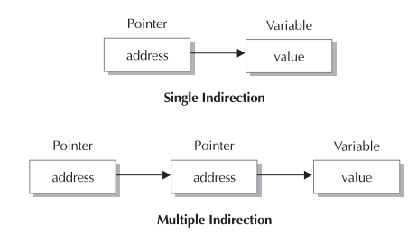

Slide 11
Contents
Address
LHS and RHS must match in ‘=‘ operation!
r
00FFF
00FE0
#include <iostream>
using namespace std;
int main()
{
int x, y, * p,*q, ** r;
x = 10; y = 12;
p = &x;
q = &y;
r = &p;
return 0;
}
p
q
0001
00FFF
0030
00EE0
x
y
10
0001
12
0030

Slide 12
Contents
Address
Value = address
Or
Address = value
r
00FFF
00FE0
Compile time error!
Not allowed
p
q
0001
00FFF
0030
00EE0
//LHS: value, RHS: address
x = &y;
x = p;
x = q;
*p = &y;
*p = &x;
x
y
//LHS: address, RHS: value
p = x;
q = x;
p = &x;
10
0001
12
0030

Slide 13
Contents
Address
What if RHS and LHS consists of varying TYPES of addresses
r
//LHS: address (pointer to int location), RHS: address (int location)
p = &x;
r = &x;
00FFF
00FE0
p
q
Compile time error!
Not allowed
0001
00FFF
0030
00EE0
//LHS: address (pointer to int location), RHS: address (address of pointer(single/multidirectional) to int location)
p = &q;
p = &r;
x
y
10
0001
12
0030
//type of addresses at RHS and LHS match!
p = &x;
q = p;
r = &p;
Correct!

Slide 14
Using different operators with pointers (Postfix and prefix)

Slide 15
Lab task 1
#include <iostream>
using namespace std;
int main()
{
int var1 = 10, var2 = 5;
int* p1, * q1, * r1;
int** g;
int var3;
var3 = ++var2;
p1 = &var1;
q1 = &var2;
r1 = &var3;
g = &r1;
*p1 = var3++;
*q1 = ++var1;
//add appropriate lines of code to print the things mentioned in the table below
return 0;
}

Slide 16
p1
q1
r1
var1
var2
var3
150
250
350
001
002
003
#include <iostream>
using namespace std;
int main()
{
int var1 = 10, var2 = 5;
int* p1, * q1, * r1;
int** g;
int var3;
var3 = ++var2;
p1 = &var1;
q1 = &var2;
r1 = &var3;
g = &r1;
*p1 = var3++;
*q1 = ++var1;
return 0;
}
Line# | p1 | q1 | r1 | g | var1 | var2 | var3
5,6,7,8 | G | G | G | G | 10 | 5 | G | int* p1, * q1, * r1;
9 | G | G | G | G | 10 | 6 | 6 | var3 = ++var2;
10 | 001 | G | G | G | 10 | 6 | 6 | p1=&var1;
11 | 001 | 002 | G | G | 10 | 6 | 6 | q1=&var2;
12 | 001 | 002 | 003 | G | 10 | 6 | 6 | r1=&var3;
13 | 001 | 002 | 003 | 350 | 10 | 6 | 6 | g=&r1
14 | 001 | 002 | 003 | 350 | 6 | 6 | 7 | *p1 = var3++;
15 | 001 | 002 | 003 | 350 | 7 | 7 | 7 | *q1 = ++var1;

Slide 17
Line# | p1 | q1 | r1 | g | var1 | var2 | var3
13 | 001 | 002 | 003 | 350 | 10 | 6 | 6 | g=&r1
p1
q1
r1
var1
var2
var3
001
150
002
250
003
350
10
001
6
002
6
003
var1
var2
var3
6
002
2
10 6
001
6 7
003
Line# | p1 | q1 | r1 | g | var1 | var2 | var3
14 | 001 | 002 | 003 | 350 | 6 | 6 | 7 | *p1 = var3++;
15 | 001 | 002 | 003 | 350 | 7 | 7 | 7 | *q1 = ++var1;
6
1
var1
var2
var3
6
001
6
002
7
003
var1
var2
var3
1
6 7
002
7
003
6 7
001
2
7

Slide 18
Postfix and prefix
The example that we covered in lab luckily deals with ++ operation involving two variables/pointers i.e. expressions like: *a=b++ or *a=++b
In this case the postfix and prefix would work as they are working
But, what if the expression with ++ operator only involves one variable/pointer. i.e. expressions like: *a++
In this case, precedence of operators will be considered by the compiler and postfix would not work as it was meant to work!

Slide 19
Consider the same code with slight adjustment in postfix/prefix expressions
#include <iostream>
using namespace std;
int main()
{
int var1 = 10, var2 = 5;
int* p1, * q1, * r1;
int** g;
int var3;
var3 = ++var2;
p1 = &var1;
q1 = &var2;
r1 = &var3;
g = &r1;
cout << "Before " << endl;
cout << "var1: " << var1 << endl;
cout << "var2: " << var2 << endl;
cout << "var3: " << var3 << endl;
*p1++;
//*q1 = ++var1;
cout << "After " << endl;
cout << "var1: " << var1 << endl;
cout << "var2: " << var2 << endl;
cout << "var3: " << var3 << endl;
return 0;
}

Slide 20
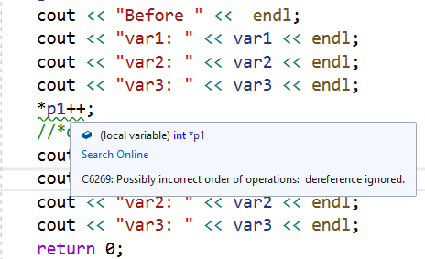
Notice a warning that compiler generates!
There are two operators used in this expression (* and ++)
Precedence of ++ is more than *, thus ++ part will be executed first.
Which says: p1++
Although you meant to do increment in the value of variable pointed by p1 (var1) through *p1, but, instead of value, the address of p1 is incremented.
The compiler throws warning to highlight this logical issue.

Slide 21
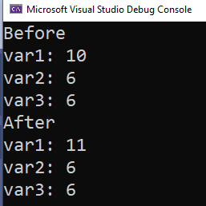
Remedy…use brackets to overcome that logical mistake!
cout << "Before " << endl;
cout << "var1: " << var1 << endl;
cout << "var2: " << var2 << endl;
cout << "var3: " << var3 << endl;
(*p1)++;
cout << "After " << endl;
cout << "var1: " << var1 << endl;
cout << "var2: " << var2 << endl;
cout << "var3: " << var3 << endl;
In this case, *p1 will be evaluated first because brackets are always evaluated first in any scenario!

Slide 22
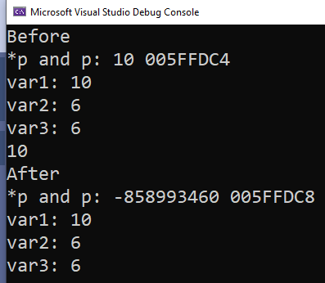
Using postfix/prefix expression in cout
In this case, *p1 will be evaluated first and its value will be displayed to the console!
Before
After
p1
var1
p1
var1
005FFDC4
150
10
005FFDC4
005FFDC8
150
10
005FFDC4
cout << "Before " << endl;
cout << "var1: " << var1 << endl;
cout << "var2: " << var2 << endl;
cout << "var3: " << var3 << endl;
cout << *p1++ << endl;
cout << "After " << endl;
cout << "var1: " << var1 << endl;
cout << "var2: " << var2 << endl;
cout << "var3: " << var3 << endl;

Slide 23
Array of primitive data type (int, char, double) and using pointers to access it

Slide 24
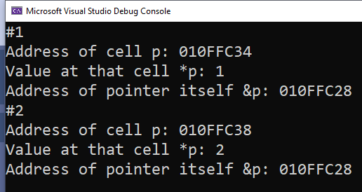
Int array and pointer
#include <iostream>
using namespace std;
int main()
{
int arr[4] = { 1,2,3,4 };
int* p;
p = arr;
cout << "#1" << endl;
cout << "Address of cell p: " << p << endl;
cout << "Value at that cell *p: " << *p << endl;
cout << "Address of pointer itself &p: " << &p << endl;
p++;
cout << "#2" << endl;
cout << "Address of cell p: " << p << endl;
cout << "Value at that cell *p: " << *p << endl;
cout << "Address of pointer itself &p: " << &p << endl;
return 0;
}
1 | 2 | 3 | 4
0 | 1 | 2 | 3
010FFC34 | 010FFC38 | 010FFC42 | 010FFC46
arr
010FFC34
010FFC28
p

Slide 25
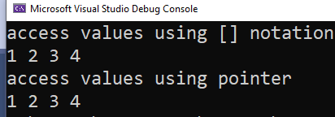
Using pointer method to access array without using square brackets
#include <iostream>
using namespace std;
int main()
{
int arr[4] = { 1,2,3,4 };
int* p;
p = arr;
cout << "access values using [] notation" << endl;
for (int i = 0; i < 4; i++)
cout << arr[i] << " ";
cout << endl;
cout << "access values using pointer" << endl;
for (int i = 0; i < 4; i++)
{
cout << *p<< " ";
p++;
}
return 0;
}

Slide 26

Directly accessing any cell of an array with pointer notation
#include <iostream>
using namespace std;
int main()
{
int arr[4] = { 11,2,32,43 };
int* p;
p = arr;
cout << "access value at 4th cell using pointer" << endl;
p=p+3;
cout << *p<< " ";
return 0;
}
Access 4th cell by adding 3 into its current address. Thus, 3 is added to base address and pointer is made to now point cell#3 instead of cell#0

Slide 27

Beware of operators’ precedence while writing any expression related to pointers!
#include <iostream>
using namespace std;
int main()
{
int arr[4] = { 11,2,32,43 };
int* p;
p = arr;
cout << "access value at 4th cell using pointer" << endl;
cout << *p+3<< " ";
return 0;
}
Although you meant to access 4th cell by adding 3 into its current value. But, *p will be evaluated first with cout and 3 is added in the current value (i.e. 11) and we get 14 displayed on the screen

Slide 28
String, char array and pointers

Slide 29
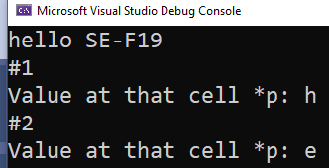
Using char array to deal with string …and using pointers
#include <iostream>
using namespace std;
int main()
{
char c[15];
char* p;
cin.getline(c, 15);
p = c;
cout << "#1" << endl;
cout << "Value at that cell *p: " << *p << endl;
p++;
cout << "#2" << endl;
cout << "Value at that cell *p: " << *p << endl;
return 0;
}
h | e | l | l | o |  | S | E | - | F | 1 | 9 | \0 | G | G
0 | 1 | 2 | 3 | 4 | 5 | 6 | 7 | 8 | 9 | 10 | 11 | 12 | 13 | 14
010FFC34 | 010FFC38 | … | … | … | … | … | … | … | … | … | … | … | … | …
c
010FFC34
00CFFCFC
p
010FFC38
00CFFCFC
p

Slide 30
For now focus on char array while practicing with string nature data. However, if you want to use built in string class then the procedure is same as described before with only one change: For string, you need to explicitly set the char pointer to cell 0 Base address notation will not work

Slide 31
Using string with pointers
#include <string>
#include <iostream>
using namespace std;
int main()
{
string c;
getline(cin, c);
char* p;
p = &c[0];
cout << "#1" << endl;
cout << "Value at that cell *p: " << *p << endl;
p++;
cout << "#2" << endl;
cout << "Value at that cell *p: " << *p << endl;
return 0;
}
h | e | l | l | o |  | S | E | - | F | 1 | 9 | \0 | G | G
0 | 1 | 2 | 3 | 4 | 5 | 6 | 7 | 8 | 9 | 10 | 11 | 12 | 13 | 14
010FFC34 | 010FFC38 | … | … | … | … | … | … | … | … | … | … | … | … | …
c
010FFC34
00CFFCFC
p
010FFC38
00CFFCFC
p

Slide 32
Lab task 3 (Bonus)

Slide 33
Write a function ReverseOrder that declares a string and take an input in it. It then reverses its order and displays it. Use only pointer notation (you are not allowed to use array subscript [] notation in the function. You can use more than one pointers and strings in this program if you need any.
Void ReverseOrder();
Example:
i) Input: This is reverse order program
Output: program order reverse is This
ii) Input: This is exercise eight
Output: eight exercise is This

Slide 34
*p
c
I |  | h | a | t | e |  | m | a | t | h | s | \0
0 | 1 | 2 | 3 | 4 | 5 | 6 | 7 | 8 | 9 | 10 | 11 | 12 | 13 | 14
001 | 002 | … | … | … | … | … | … | … | … | … | … | … | … | …
Idea is to traverse the string from the end, extract words, and side by side print them too
Extract words from the string and then display them by inverting their order. That is, first display the last word (maths), then second last (hate)..and so on till you reach first word (I)
Words can be extracted by iterating through an array and checking whether you encounter a space or not. If you encounter a space then that means a word has just been ended
Iterate through the string using a pointer. Initialize it to the stating cell and then gradually move forward or backward (according to your designed algorithm)

Slide 35
Steps Logic..

Slide 36
*p
#1
c
I |  | h | a | t | e |  | m | a | t | h | s | \0
0 | 1 | 2 | 3 | 4 | 5 | 6 | 7 | 8 | 9 | 10 | 11 | 12 | 13 | 14
001 | 002 | … | … | … | … | … | … | … | … | … | … | … | … | …
Iterate through an array and set the pointer to the end of an array
Or directly set the pointer to the end of an array
Or start accessing or iterating through an array from the end

Slide 37
*p
#2
c
I |  | h | a | t | e |  | m | a | t | h | s | \0
0 | 1 | 2 | 3 | 4 | 5 | 6 | 7 | 8 | 9 | 10 | 11 | 12 | 13 | 14
001 | 002 | … | … | … | … | … | … | … | … | … | … | … | … | …
Continue decrementing pointer till you reach at the start of the last word
Notice that the start of this last word will be indicated by a space ‘ ’ character
Hint: you can use if statement to check if you encounter a space while traversing
Once you reach that point then it is now a time to display that last word
Iterate through the string using pointer till you read and display that word
Don’t forget to store index location where you encounter a space..just to continue with your algorithm after printing last word

Slide 38
*p
#3
c
I |  | h | a | t | e |  | m | a | t | h | s | \0
0 | 1 | 2 | 3 | 4 | 5 | 6 | 7 | 8 | 9 | 10 | 11 | 12 | 13 | 14
001 | 002 | … | … | … | … | … | … | … | … | … | … | … | … | …
Continue with the same algorithm/logic and reach a point at where you encounter a second space (while moving backward)
Once you reach that point then it is now a time to display that second last word
Iterate through the string using pointer till you read and display that word
Don’t forget to store index location where you encounter a space..just to continue with your algorithm after printing second last word

Slide 39
You can continue moving backward till you index is greater than equal to 0!
In short, this will help in checking if you have reached the first character of your input string!

Slide 40
Code (try yourself first, use this solution only for reference)
#include <iostream>
#include <cstring>
using namespace std;
void reverse(char* sentence)
{
int index = strlen(sentence) - 1, hold, last = '\0';
/*For the 1st iteration last is `\0` for all others it is ` `*/
while (index >= 0)
{
while (index >= 0 && sentence[index] != ' ')
index--;
hold = index - 1; // This keeps track of the last character of preceding word
index++; //character after space
while (sentence[index] != last)
{
cout << sentence[index];
index++;
}
last = ' ';
index = hold;
/* Dont print space after 1st word*/
if (index > 0)
cout << " ";
}
}
int main()
{
char* sentence = new char[256];
cin.getline(sentence, 256);
reverse(sentence);
delete[] sentence;
}

Slide 41
Array of pointers

Slide 42
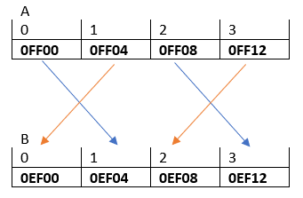
Lab task 2
Task was to create a link between two arrays.
To create a link, it is obvious that A must be a pointer only then we can point its cells to somewhere.
However, there is no restriction imposed on B. B can be an integer array of an array of pointers to integer
Index of an array
Memory address
Index of an array
Memory address

Slide 43
Case 1: int ** A[4]; int * B[4]
Since A is an array of pointers to a pointer, thus its contents would be a pointer i.e. an address to pointer
A
0 | 1 | 2 | 3
0E000 | 0E004 | 0E008 | 0E012
int ** A[4];
Since B is an array of pointers, thus its contents would be an address to an integer value
B
0 | 1 | 2 | 3
0FF00 | 0FF04 | 0FF08 | 0FF12
int *B[4]
Both the arrays A and B will have a dedicated memory address (e.g. 0E000, 0FF00 etc.), allocated by the compiler.

Slide 44
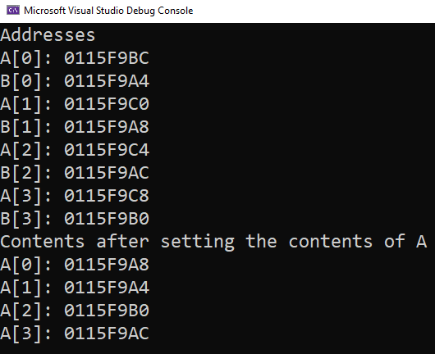
.. A8 | ..A4 | .. B0 | .. AC
0 | 1 | 2 | 3
0115F9BC | .. C0 | .. C4 | .. C8
A
0 | 1 | 2 | 3
0115F9A4 | .. A8 | .. AC | .. B0
B

Slide 45
What if? int* A[4]; int* B[4]; instead of int** A[4]; int* B[4];
Compile time error!

Slide 46
The addresses’ types also match in LHS and RHS!
Since A is an array of pointers, thus its contents would be a pointer i.e. an address to pointer to an int location
A
0 | 1 | 2 | 3
0E000 | 0E004 | 0E008 | 0E012
int ** A[4];
Since B is an array of integers, thus its contents would be pointer i.e. an address to a int location
B
0 | 1 | 2 | 3
0FF00 | 0FF04 | 0FF08 | 0FF12
Int* B[4]
A[0] = &B[1];
Address to a pointer
Address to an integer

Slide 47
Case 2: int * A[4]; int B[4]
Since A is an array of pointers, thus its contents would be a pointer i.e. an address to int location
A
0 | 1 | 2 | 3
0E000 | 0E004 | 0E008 | 0E012
int * A[4];
Since B is an array of integers, thus its contents would be an integer value
B
0 | 1 | 2 | 3
0FF00 | 0FF04 | 0FF08 | 0FF12
int B[4]
Both the arrays A and B will have a dedicated memory address (e.g. 0E000, 0FF00 etc.), allocated by the compiler.

Slide 48
Practice questions v10
Q1

Slide 49
Dynamic arrays

Slide 50
new and delete keyword
C++ contains two operators, new and delete, that perform the functions of allocating and freeing memory.
Their general forms are shown here:
pointer-var = new var-type;
delete pointer-var;
Here, pointer-var is a pointer of type var-type. The new operator allocates sufficient memory to hold a value of type var-type and returns a pointer to it. Any valid data type can be allocated using new.
The delete operator frees the memory pointed to by pointer-var. Once freed, this memory can be reallocated to different purposes by a subsequent new allocation request.

Slide 51
Dynamic memory allocation
#include <iostream>
using namespace std;
int main()
{
int* p;
p = new int; // allocate memory for int
*p = 20; // assign that memory the value 20
cout << *p; // prove that it works by displaying value
delete p; // free the memory
return 0;
}

Slide 52
Practice questions v10
Q2

Slide 53
Q2
Memory
#include <iostream>
using namespace std;
int main()
{
int* p1, * p2;
p1 = new int;
p2 = new int;
*p1 = 10;
*p2 = 20;
cout << *p1 << " " << *p2 << endl;
p1 = p2;
cout << *p1 << " " << *p2 << endl;
*p1 = 30;
cout << *p1 << " " << *p2 << endl;
}
0010 | G
.. | G
.. | G
.. | G
0044 | G
.. | G
.. | G
0500 | G
.. | G
0900 | G
.. | G
.. | G
p1
0500
0010
p2
0900
0044

Slide 54
Q2
Memory
#include <iostream>
using namespace std;
int main()
{
int* p1, * p2;
p1 = new int;
p2 = new int;
*p1 = 10;
*p2 = 20;
cout << *p1 << " " << *p2 << endl;
p1 = p2;
cout << *p1 << " " << *p2 << endl;
*p1 = 30;
cout << *p1 << " " << *p2 << endl;
}
0010 | G
.. | G
.. | G
.. | G
0044 | G
.. | G
.. | G
0500 | 10
.. | G
0900 | 20
.. | G
.. | G
p1
0500
0010
p2
0900
0044

Slide 55
Q2
Output:
20
Memory
#include <iostream>
using namespace std;
int main()
{
int* p1, * p2;
p1 = new int;
p2 = new int;
*p1 = 10;
*p2 = 20;
cout << *p1 << " " << *p2 << endl;
p1 = p2;
cout << *p1 << " " << *p2 << endl;
*p1 = 30;
cout << *p1 << " " << *p2 << endl;
}
0010 | G
.. | G
.. | G
.. | G
0044 | G
.. | G
.. | G
0500 | 10
.. | G
0900 | 20
.. | G
.. | G
p1
0900
0010
p2
0900
0044

Slide 56
Q2
Output:
20
20 20
Memory
#include <iostream>
using namespace std;
int main()
{
int* p1, * p2;
p1 = new int;
p2 = new int;
*p1 = 10;
*p2 = 20;
cout << *p1 << " " << *p2 << endl;
p1 = p2;
cout << *p1 << " " << *p2 << endl;
*p1 = 30;
cout << *p1 << " " << *p2 << endl;
}
0010 | G
.. | G
.. | G
.. | G
0044 | G
.. | G
.. | G
0500 | 10
.. | G
0900 | 20 30
.. | G
.. | G
p1
0900
0010
p2
0900
0044

Slide 57
Q2
Output:
20
20
30 30
Memory
#include <iostream>
using namespace std;
int main()
{
int* p1, * p2;
p1 = new int;
p2 = new int;
*p1 = 10;
*p2 = 20;
cout << *p1 << " " << *p2 << endl;
p1 = p2;
cout << *p1 << " " << *p2 << endl;
*p1 = 30;
cout << *p1 << " " << *p2 << endl;
}
0010 | G
.. | G
.. | G
.. | G
0044 | G
.. | G
.. | G
0500 | 10
.. | G
0900 | 20 30
.. | G
.. | G
p1
0900
0010
p2
0900
0044

Slide 58
Allocating arrays
Everything is same as we have done for allocating one memory location dynamically.
Now we are going to explore how to allocate arrays
Syntax for allocating and deallocating memory for arrays is:
pointer-var = new type [size];
delete [ ] pointer-var;

Slide 59
#include <iostream>
using namespace std;
int main()
{
int* p;
int i;
p = new int[10]; // get a 10-element array
for (i = 0; i < 10; i++)
p[i] = i;
delete[] p; // delete the entire array
return 0;
}
0 | 1 | 2 | 3 | 4 | 5 | 6 | 7 | 8 | 9
0000 | 0004 | 0008 | 0012 | 0016 | 0020 | 0024 | 0028 | 0032 | 0036
p

Slide 60
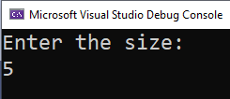
You can now have user defined size array with dynamic allocation
#include <iostream>
using namespace std;
int main()
{
int* p;
int size = 0;
cout << "Enter the size:" << endl;
cin >> size;
p = new int[size]; // get a 10-element array
for (int i = 0; i < size; i++)
p[i] = i;
delete[] p; // delete the entire array
return 0;
}
Make sure to access only those memory that you allocated, otherwise your compiler will give exception in this case

Slide 61
Practice questions v10
Q4

Slide 62
Q4
#include <iostream>
using namespace std;
int main()
{
int array_size = 10;
int* a;
a = new int[array_size];
int i;
for (i = 0; i < array_size; i++)
*(a + i) = i;
for (i = 0; i < array_size; i++)
cout << a[i] << " ";
cout << endl;
}
G | G | G | G | G | G | G | G | G | G
0 | 1 | 2 | 3 | 4 | 5 | 6 | 7 | 8 | 9
001 | 002 | 003 | 004 | 005 | 006 | 007 | 008 | 009 | 010
001
0FF0
a

Slide 63
Q4
#include <iostream>
using namespace std;
int main()
{
int array_size = 10;
int* a;
a = new int[array_size];
int i;
for (i = 0; i < array_size; i++)
*(a + i) = i;
for (i = 0; i < array_size; i++)
cout << a[i] << " ";
cout << endl;
}
G 0 | G | G | G | G | G | G | G | G | G
0 | 1 | 2 | 3 | 4 | 5 | 6 | 7 | 8 | 9
001 | 002 | 003 | 004 | 005 | 006 | 007 | 008 | 009 | 010
Iteration#0:
i=0
001
0FF0
a
*(a+i) = i
*(001+0) = 0
*(001) = 0
Value at 001 = 0

Slide 64
Q4
#include <iostream>
using namespace std;
int main()
{
int array_size = 10;
int* a;
a = new int[array_size];
int i;
for (i = 0; i < array_size; i++)
*(a + i) = i;
for (i = 0; i < array_size; i++)
cout << a[i] << " ";
cout << endl;
}
0 | G 1 | G | G | G | G | G | G | G | G
0 | 1 | 2 | 3 | 4 | 5 | 6 | 7 | 8 | 9
001 | 002 | 003 | 004 | 005 | 006 | 007 | 008 | 009 | 010
Iteration#1:
i=1
a
001
0FF0
*(a+i) = i
*(001+1) = 1
*(002) = 1
Value at 002 = 1

Slide 65
And the procedure continues till i=9…
0 | 1 | 2 | 3 | 4 | 5 | 6 | 7 | 8 | 9
0 | 1 | 2 | 3 | 4 | 5 | 6 | 7 | 8 | 9
001 | 002 | 003 | 004 | 005 | 006 | 007 | 008 | 009 | 010
a
001
0FF0

Slide 66
Pointers in functions
C++ allows you to pass a pointer to a function.

Slide 67
Example 1: pointer = variable’s address assignment
Pass by Pointer
#include <iostream>
using namespace std;
void printAge(int* age);
int main() {
int num = 26;
int* age;
age = &num;
return 0;
}
num
age
26
010FFC7C
010FFC7C
010FFBA8

Slide 68
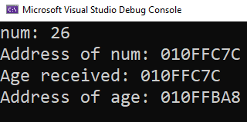
Example 1
#include <iostream>
using namespace std;
void func(int *age);
int main() {
int num=26;
cout << "num: " << num << endl;
cout << "Address of num: " << &num << endl;
func(&num);
return 0;
}
void func(int *age) {
cout << "Age received: " << age << endl;
cout << "Address of age: " << &age << endl;
}
num
age
26
010FFC7C
010FFC7C
010FFBA8
age = &num;
pointer = address;

Slide 69
Example 2: pointer = pointer assignment
P is replicated..
(copy of p’s contents is created)
x
p
0090FB7C
0090FB70
0090FB7C
0090FA9C
#include <iostream>
using namespace std;
int main()
{
int age = 0; int* p; int* x;
p = &age;
x = p;
return 0;
}
age
0
0090FB7C
x is initialized with contents of p. That is, x also points where p was pointing. Because contents of pointer decide where to point!

Slide 70
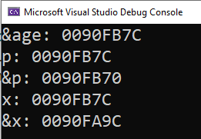
p
P is replicated..
(copy of p’s contents is created)
x
#include <iostream>
using namespace std;
void printAge(int *x);
int main() {
int age=0; int* p;
p = &age;
cout << "&age: " << &age << endl;
cout << "p: " << p << endl;
cout << "&p: " << &p << endl;
printAge(p);
return 0;
}
void printAge(int *x) {
cout << "x: " << x << endl;
cout << "&x: " << &x << endl;
}
0090FB7C
0090FB70
0090FB7C
0090FA9C
age
0
0090FB7C
x is initialized with contents of p. That is, x also points where p was pointing
x = p;
pointer = pointer;

Slide 71
Practice questions v10
Q1

Slide 72
What is the output of this program?
#include <iostream>
using namespace std;
int main()
{
int a[4] = { 1, 2, 3, 4 };
cout << *(a + 2) << (*(a) + (2*5)) ;
return 0;
}
A.3 1 7
B. 31 1
C. 8 8 8
D. Compile time error
0 | 1 | 2 | 3
1 | 2 | 3 | 4
0000 | 0001 | 0002 | 0003
a
a: base address: 0000
*(a + 2) (*(a) + (2*5))
*(0000 + 2) (*(0000) + (10))
*(0002) (1 + 10)
3 (1 + 10)
3 11

Slide 73
#include <iostream>
using namespace std;
void mystery1(char*, const char*);
int main()
{
char string1[80];
char string2[80];
cout << "Enter two strings: ";
cin >> string1 >> string2;
mystery1(string1, string2);
cout << string1 << endl;
}
void mystery1(char* s1, const char* s2)
{
while (*s1 != '\0’)
++s1;
for (; (*s1 = *s2); ++s1, ++s2)
{
}
}
string1
H | e | l | l | o | \0
0 | 1 | 2 | 3 | 4 | 5 | 6 | 7 | 8 | - | 79
001 | 002 | 003 | 004 | 005 | 006 | 007 | 008 | 009 | 010 | 011
S | E | \0
0 | 1 | 2 | 3 | 4 | 5 | 6 | 7 | 8 | - | 79
011 | 012 | 013 | 014 | 015 | 016 | 017 | 018 | 019 | 020 | 021
string2
Formal param1,param2,..param n func call (Passed param1,param2,..param n)
s1,s2 mystery1 (string1, string 2)
Base address copied to formal parameters
001
00CFFCFC
s1
011
0EEECFC
s2

Slide 74
void mystery1(char* s1, const char* s2)
{
while (*s1 != '\0’)
++s1;
for (; (*s1 = *s2); ++s1, ++s2)
{
}
}
s1
001
00CFFCFC
s1
H | e | l | l | o | \0
0 | 1 | 2 | 3 | 4 | 5 | 6 | 7 | 8 | - | 79
001 | 002 | 003 | 004 | 005 | 006 | 007 | 008 | 009 | 010 | 011
string1
s2
011
00EEECFC
s2
S | E | \0
0 | 1 | 2 | 3 | 4 | 5 | 6 | 7 | 8 | - | 79
011 | 012 | 013 | 014 | 015 | 016 | 017 | 018 | 019 | 020 | 021
string2

Slide 75
void mystery1(char* s1, const char* s2)
{
while (*s1 != '\0’)
++s1;
for (; (*s1 = *s2); ++s1, ++s2)
{
}
}
s1
006
00CFFCFC
s1
H | e | l | l | o | \0
0 | 1 | 2 | 3 | 4 | 5 | 6 | 7 | 8 | - | 79
001 | 002 | 003 | 004 | 005 | 006 | 007 | 008 | 009 | 010 | 011
string1
s2
011
00EEECFC
s2
S | E | \0
0 | 1 | 2 | 3 | 4 | 5 | 6 | 7 | 8 | - | 79
011 | 012 | 013 | 014 | 015 | 016 | 017 | 018 | 019 | 020 | 021
string2

Slide 76
void mystery1(char* s1, const char* s2)
{
while (*s1 != '\0’)
++s1;
for (; (*s1 = *s2); ++s1, ++s2)
{
}
}
s1
006
00CFFCFC
s1
H | e | l | l | o | \0
0 | 1 | 2 | 3 | 4 | 5 | 6 | 7 | 8 | - | 79
001 | 002 | 003 | 004 | 005 | 006 | 007 | 008 | 009 | 010 | 011
string1
s2
011
00EEECFC
s2
S | E | \0
0 | 1 | 2 | 3 | 4 | 5 | 6 | 7 | 8 | - | 79
011 | 012 | 013 | 014 | 015 | 016 | 017 | 018 | 019 | 020 | 021
string2

Slide 77
Iteration#1
*s1 = *s2
Value at 006 = value at 011
Value at 006 = ‘S’
for (; (*s1 = *s2); ++s1, ++s2)
{
}
s1
006
00CFFCFC
s1
H | e | l | l | o | \0 S
0 | 1 | 2 | 3 | 4 | 5 | 6 | 7 | 8 | - | 79
001 | 002 | 003 | 004 | 005 | 006 | 007 | 008 | 009 | 010 | 011
string1
s2
*s1 = *s2
Is an expression. Expressions in C/C++ evaluates to values, and in this case it returns the value assigned to *s1.
When the '\0' is assigned to *s1, the expression evaluates to 0 which is false clearly.
011
00EEECFC
s2
S | E | \0
0 | 1 | 2 | 3 | - | 79
011 | 012 | 013 | 014 | 020 | 021
string2

Slide 78
Iteration#2
for (; (*s1 = *s2); ++s1, ++s2)
{
}
s1
007
00CFFCFC
s1
H | e | l | l | o | S
0 | 1 | 2 | 3 | 4 | 5 | 6 | 7 | 8 | - | 79
001 | 002 | 003 | 004 | 005 | 006 | 007 | 008 | 009 | 010 | 011
string1
s2
012
00EEECFC
s2
S | E | \0
0 | 1 | 2 | 3 | 4 | 5 | 6 | 7 | 8 | - | 79
011 | 012 | 013 | 014 | 015 | 016 | 017 | 018 | 019 | 020 | 021
string2

Slide 79
true
Iteration#3
*s1 = *s2
Value at 007 = value at 012
Value at 007 = ‘E’
for (; (*s1 = *s2); ++s1, ++s2)
{
}
This expression returns ‘E’
s1
007
00CFFCFC
s1
H | e | l | l | o | S | E
0 | 1 | 2 | 3 | 4 | 5 | 6 | 7 | 8 | - | 79
001 | 002 | 003 | 004 | 005 | 006 | 007 | 008 | 009 | 010 | 011
string1
s2
012
00EEECFC
s2
S | E | \0
0 | 1 | 2 | 3 | 4 | 5 | 6 | 7 | 8 | - | 79
011 | 012 | 013 | 014 | 015 | 016 | 017 | 018 | 019 | 020 | 021
string2

Slide 80
Iteration#4
for (; (*s1 = *s2); ++s1, ++s2)
{
}
s1
008
00CFFCFC
s1
H | e | l | l | o | S | E
0 | 1 | 2 | 3 | 4 | 5 | 6 | 7 | 8 | - | 79
001 | 002 | 003 | 004 | 005 | 006 | 007 | 008 | 009 | 010 | 011
string1
s2
013
00EEECFC
s2
S | E | \0
0 | 1 | 2 | 3 | 4 | 5 | 6 | 7 | 8 | - | 79
011 | 012 | 013 | 014 | 015 | 016 | 017 | 018 | 019 | 020 | 021
string2

Slide 81
*s1 = *s2
Iteration#5
false
Value at 008 = value at 013
Value at 008 = ‘\0’
for (; (*s1 = *s2); ++s1, ++s2)
{
}
This expression returns ‘\0’
i.e. 0
Conditional part evaluated to false, thus stop the loop!
s1
008
00CFFCFC
s1
string1
H | e | l | l | o | S | E
0 | 1 | 2 | 3 | 4 | 5 | 6 | 7 | 8 | - | 79
001 | 002 | 003 | 004 | 005 | 006 | 007 | 008 | 009 | 010 | 011
s2
013
00EEECFC
s2
S | E | \0
0 | 1 | 2 | 3 | 4 | 5 | 6 | 7 | 8 | - | 79
011 | 012 | 013 | 014 | 015 | 016 | 017 | 018 | 019 | 020 | 021
string2

Slide 82
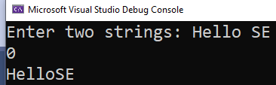
Output
string1
H | e | l | l | o | S | E
0 | 1 | 2 | 3 | 4 | 5 | 6 | 7 | 8 | - | 79
001 | 002 | 003 | 004 | 005 | 006 | 007 | 008 | 009 | 010 | 011
#include <iostream>
using namespace std;
void mystery1(char*, const char*);
int main()
{
char string1[80];
char string2[80];
cout << "Enter two strings: ";
cin >> string1 >> string2;
mystery1(string1, string2);
cout << string1 << endl;
}

